Slide 1
Unit – 4 Quality Management
Management of IT Industries

Slide 2
What is Quality?
Quality is
a degree of excellence to fulfill the requirements.
Totality of features and characteristics of a product or services to satisfy a given need.
conformance to requirements: meeting written specifications.
fitness for purpose: ensuring a product can be used as it was intended.

Slide 3
Importance of Quality?
Quality= Customer satisfaction=Business growth
Quality= Pride in delivery= Higher team morale
Lack of quality= loss in money
Lack of quality= loss of customer satisfaction= loss of reputation= difficult in getting or start new business
Lack of quality could lead to loss of life

Slide 4
Project Quality Management
Project quality management ensures that the project will satisfy the needs for which it was undertaken
If Quality is an end point for any project, then “Quality Management” is the approach and process for getting quality.
Basic approach to Quality discussed here is intended to be compatible with standards like International Organization for Standardization (ISO) norms.
Processes and Activities of the performing organization that determine quality policies, objectives, and responsibilities so that the project will satisfy the needs for which it was undertaken.

Slide 5
Contd…
The International Organization for Standardization (ISO) defines quality as the totality of characteristics of an entity that bear on its ability to satisfy stated or implied needs
Quality concerned with the Prevention over Inspection. ( Inspection is typically used to prove that system works properly rather than a way to reject the failure.)
A good quote to remember is “Quality should be planned in not inspected in ” because the cost of rework can be very high.
Project managers are ultimately responsible for quality management on their projects
Several organizations and references can help project managers and their teams understand quality
International Organization for Standardization (www.iso.org)
When products, systems, machinery and devices work well and safely, it is often because they meet standards. The organization responsible for many thousands of the standards which benefit the world is ISO ike ISO12207 Systems and software engineering — Software life cycle processes, ISO 25011 Information technology -- Service Quality Requirement and Evaluation(SQuaRE) -- IT Service Quality Model, etc.
IEEE – Standards Association (www.ieee.org)
A leading, developer of industry standards in a broad-range of industries (Power and Energy, Information Technology, Telecommunications, Transportation, Medical and Healthcare, nanotechnology, cyber security, information assurance, and green technology) . Globally recognized

Slide 6
Quality Management Processes
Quality planning: Identifying which quality standards are relevant to the project and how to satisfy them.
Quality control: Monitoring specific project results to ensure that they comply with the relevant quality standards while identifying ways to improve overall quality and eliminate causes of unsatisfactory performance.
Quality assurance: Evaluating overall project performance to ensure the project will satisfy the relevant quality standards. “QA makes sure you are doing the right things in the right way.”

Slide 7
Quality Experts
Deming was famous for his work in rebuilding Japan and his 14 points
Juran wrote the Quality Control Handbook and 10 steps to quality improvement
Crosby wrote Quality is Free and suggested that organizations strive for zero defects
Ishikawa developed the concept of quality circles and using fishbone diagrams
Taguchi developed methods for optimizing the process of engineering experimentation
Feigenbaum developed the concept of total quality control

Slide 8
Who’s Responsible for the Quality of Projects?
Project managers are ultimately responsible for quality management on their projects.
Several organizations and references can help project managers and their teams understand about quality
International Organization for Standardization (www.iso.org)
When products, systems, machinery and devices work well and safely, it is often because they meet standards. The organization responsible for many thousands of the standards which benefit the world is ISO ike ISO12207 Systems and software engineering — Software life cycle processes, ISO 25011 Information technology -- Service Quality Requirement and Evaluation(SQuaRE) -- IT Service Quality Model, etc.
IEEE – Standards Association (www.ieee.org)
A leading, developer of industry standards in a broad-range of industries (Power and Energy, Information Technology, Telecommunications, Transportation, Medical and Healthcare, nanotechnology, cyber security, information assurance, and green technology) .
Note:
The ISO 9000 family addresses various aspects of quality management and contains some of ISO’s best known standards. The standards provide guidance and tools for companies and organizations who want to ensure that their products and services consistently meet customer’s requirements, and that quality is consistently improved. This standard is based on a number of quality management principles including a strong customer focus, the motivation and implication of top management, the process approach and continual improvement.

Slide 9
Quality Planning
Quality planning Implies the ability to anticipate situations and prepare actions to bring about the desired outcome.
A quality plan is a document that together specify quality standards, practices, resources, specifications, and the sequence of activities relevant to a particular product, service, project, or contract.
The Components of a Project Quality Plan:
Responsibility of Management
Document Management and Control
Requirements Scope
Design Control
Testing and Quality Assurance
Defect Management
Risks & Mitigation
Many scope aspects of IT projects like functionality, features, system outputs, performance, reliability, and maintainability
1- INPUTS
-Quality policy
-Scope statement
Product description
Standards and regulations
2- TOOLS AND TECH.
benefit/ cost analysis
Benchmarking
Design of experiments
3- OUTPUTS
Quality management plan
Operational definitions
checklists
Inputs to other processes

Slide 10
Design of Experiments
Design of experiments (DOE) is a quality planning technique that helps identify which variables have the most influence on the overall outcome of a process
Computer chip designer would determine what combination of materials and equipment will produce the most reliable chips at a reasonable cost
Design of experiments is a systematic method to determine the relationship between factors affecting a process and the output of that process. In other words, it is used to find cause-and-effect relationships. This information is needed to manage process inputs in order to optimize the output.
Also applies to project management issues, such as cost and schedule trade-offs. An appropriately designed experiment to compute` project costs and durations for various combinations of staff can help determine an optimal mix of personnel
Involves documenting important factors that directly contribute to meeting customer requirements

Slide 11
Quality Assurance
Quality assurance includes all the activities related to evaluating the product quality that should satisfying the desired quality standards.
Another goal of quality assurance is continuous quality improvement
Benchmarking generates ideas for quality improvements by comparing specific project practices or product characteristics to those of other projects or products within or outside the performing organization.
A quality audit is a structured review of specific quality management activities that help identify lessons learned that could improve performance on current or future projects.
Performed by in-house auditors or third parties
1- INPUTS
-Quality management plan
-Result of quality control measurements
Operational definitions
2- TOOLS AND TECH.
Quality planning tools and techniques
Quality audits
3- OUTPUTS
Quality improvement

Slide 12
Quality Control
Quality control (QC) is a procedure or set of procedures intended to ensure that a manufactured product or performed service adheres to a defined set of quality criteria or meets the requirements of the client or customer. Quality control is the observation techniques and activities used to fulfill requirements for quality.
In project quality management, the project manager and the project team must to inspect the accomplished work to ensure its alignment with the project scope.
Controls include product inspection, where every product is examined visually, and often using a stereo microscope for fine detail before the product is sold into the external market.
Quality control emphasizes testing of products to uncover defects and reporting to management who make the decision to allow or deny product release.
Although one of the main goals of QC is to improve quality, its main outcomes are:
Acceptance decisions- are the products/services acceptable or should they be rejected and rework is then necessary
Rework – action taken to bring rejected items into compliance with products specs. Can be very expensive
Process adjustments – correct or prevent further quality problems based on quality control measurements (purchase faster server if response time is too slow)
1- INPUTS
-work results
-quality management plan
Operational definitions
Checklists
2- TOOLS AND TECH.
Control charts
Pareto diagrams
Statistical sampling
Cause-effect diagram
Etc.
3- OUTPUTS
Quality improvement
Acceptance decisions
Rework
Process adjustment

Slide 13
Quality Control Tools
Start your quality journey by mastering these tools:
Pareto chart: Shows on a bar graph which focuses on significant factors that can affect quality.
Cause-and-effect diagram (also called Ishikawa or fishbone chart): Identifies many possible causes for an effect or problem and sort ideas into useful categories.
Control chart: Graphs used to study how a process changes over time.
Check sheet: A structured, prepared form for collecting and analyzing data; a generic tool that can be adapted for a wide variety of purposes.
Histogram: The most commonly used graph for showing frequency distributions, or how often each different value in a set of data occurs.
Scatter diagram: Graphs pairs of numerical data, one variable on each axis, to look for a relationship.
Run Chart: A technique that separates data gathered from a variety of sources so that patterns can be seen (some lists replace “stratification” with “flowchart” or “Stratification”).

Slide 14
Pareto Analysis
A Pareto chart is a histogram that can help you identify and prioritize problem areas.
Pareto Analysis is a statistical technique in decision-making used for the selection of a limited number of tasks that produce significant overall effect. It uses the Pareto Principle (also known as the 80/20 rule) the idea that by doing 20% of the work you can generate 80% of the benefit of doing the entire job. In terms of quality improvement, a large majority of problems (80%) are produced by a few key causes (20%). This is also known as the vital few and the trivial many.
This technique helps to identify the top portion of causes that need to be addressed to resolve the majority of problems. Once the predominant causes are identified, then tools like the Ishikawa diagram or Fish-bone Analysis can be used to identify the root causes of the problems.
A Pareto chart, also called a Pareto distribution diagram, is a vertical bar graph in which values are plotted in decreasing order of relative frequency from left to right. Pareto charts are extremely useful for analyzing what problems need attention first because the taller bars( frequency ) on the chart, clearly illustrate which variables have the greatest cumulative effect on a given system.

Slide 15
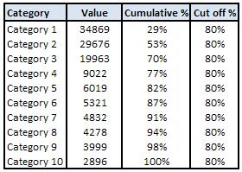
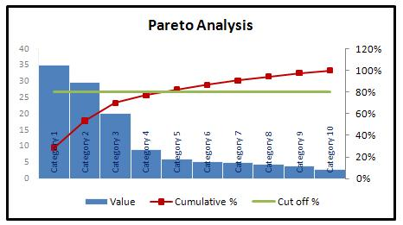
Contd.
When to Use a Pareto Chart
When analyzing data about the frequency of problems or causes in a process.
When there are many problems or causes and you want to focus on the most significant.
When analyzing broad causes by looking at their specific components.
When communicating with others about your data.

Slide 16
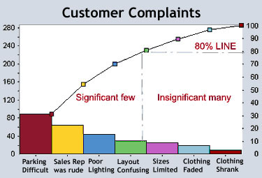
Pareto Chart:
Example: XYZ Clothing Store was seeing a steady decline in business. Before the manager did a customer survey, he assumed the decline was due to customer dissatisfaction with the clothing line he was selling and he blamed his supply chain for his problems. After charting the frequency of the answers in his customer survey, however, it was very clear that the real reasons for the decline of his business had nothing to do with his supply chain. By collecting data and displaying it in a Pareto chart, the manager could see which variables were having the most influence. In this example, parking difficulties, rude sales people and poor lighting were hurting his business most. Following the Pareto Principle, those are the areas where he should focus his attention to build his business back up.
An Example for Clothing store

Slide 17
Contd.
Steps to identify the important causes:
Form an explicit table listing the causes and their frequency as a percentage.
Arrange the rows in the decreasing order of importance of the causes (i.e., the most important cause first)
Add a cumulative percentage column to the table
Plot with causes on x- and cumulative percentage on y-axis
Join the above points to form a curve
Plot (on the same graph) a bar graph with causes on x- and percent frequency on y-axis
Draw a line at 80% on y-axis parallel to x-axis. Then drop the line at the point of intersection with the curve on x-axis. This point on the x-axis separates the important causes (on the left) and trivial causes (on the right)
Explicitly review the chart to ensure that causes for at least 80% of the problems are captured

Slide 18
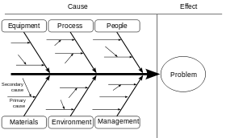
Cause-and-effect diagrams
Also called fishbone diagrams, herringbone diagrams, Ishikawa diagrams, or Fishikawa.
The fishbone diagram identifies possible causes and related problems for an effect or major problem. It can be used to structure a brainstorming session. It immediately sorts ideas into useful categories.
Common uses of the Ishikawa diagram are product design and quality defect prevention to identify potential factors causing an overall effect.
Can also use the “why” technique where you repeat the question “Why” (five is a good rule of thumb) to peel away the layers of symptoms that can lead to the root cause
When to Use a Fishbone Diagram
Want to identifying possible causes for a problem.
Especially when a team’s thinking tends to fall
into pool of problems.

Slide 19
Fishbone Diagram Procedure
Materials needed: flipchart or whiteboard, marking pens.
Agree on a problem statement (effect). Write it at the center right of the flipchart or whiteboard. Draw a box around it and draw a horizontal arrow running to it.
Brainstorm the major categories of causes of the problem. If this is difficult use generic headings:
Methods
Machines (equipment)
People (manpower)
Materials
Measurement
Environment
Write the categories of causes as branches from the main arrow.
Brainstorm all the possible causes of the problem. Ask: “Why does this happen?” As each idea is given, the facilitator writes it as a branch from the appropriate category. Causes can be written in several places if they relate to several categories.
Again ask “why does this happen?” about each cause. Write sub–causes branching off the causes. Continue to ask “Why?” and generate deeper levels of causes. Layers of branches indicate causal relationships.
When the group runs out of ideas, focus attention to places on the chart where ideas are few.

Slide 20
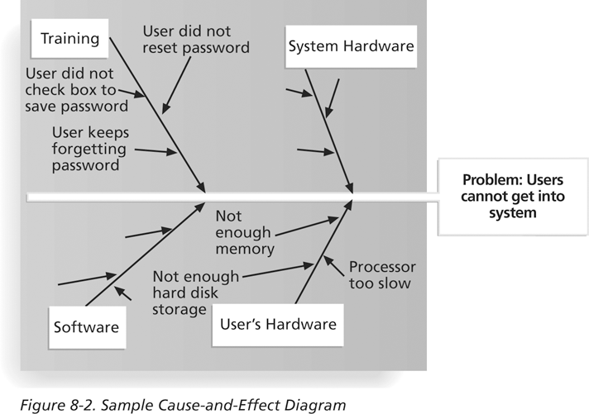
An Example

Slide 21
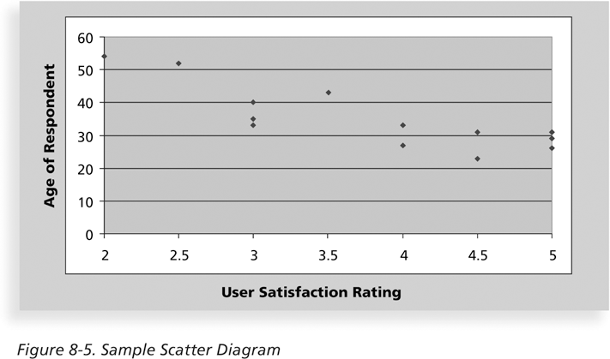
Scatter Diagram
A scatter diagram helps to show if there is a relationship between two variables, with one variable on each axis, to look for a relationship between them.
The closer data points are to a diagonal line or curve, the more closely the two variables are related.
When to use:
When you have paired numerical data.
When your dependent variable may have multiple values for each value of your independent variable.
When trying to determine whether the two variables are related.

Slide 22
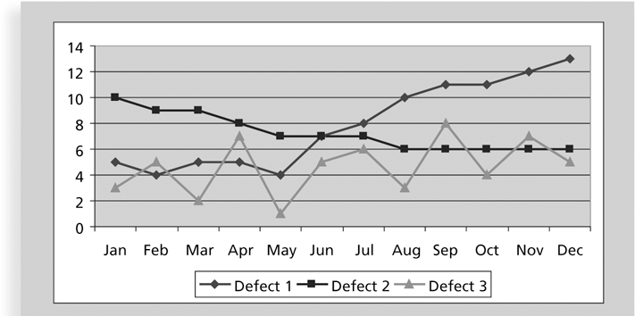
Run Chart or Stratification
A run chart displays the history and pattern of variation of a process over the time.
It is a line chart that shows data points plotted in the order in which they occur
Can be used to perform trend analysis to forecast future outcomes based on historical patterns e.g., of defects

Slide 23
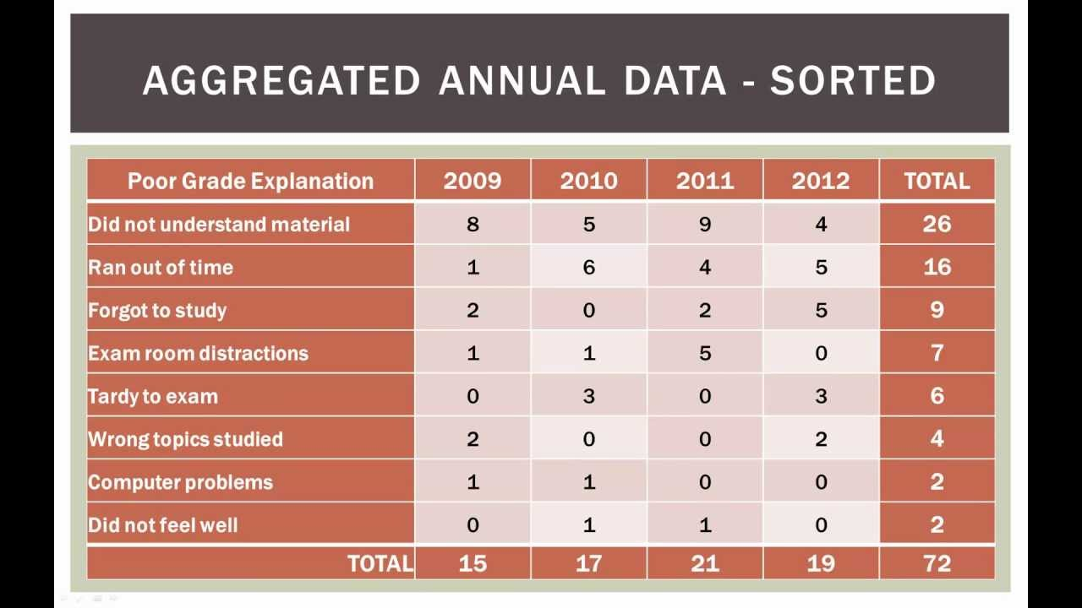
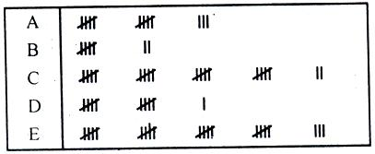
Check Sheet
The check sheet is a simple document that is used for data collection in which the results may be interpreted on the form directly without any additional processing.
A defining characteristic of a check sheet is that data is recorded by making marks (“checks”) on it.
The document is typically a blank form that is designed for the quick, easy, and efficient recording of the desired information, which can be either quantitative or qualitative.

Slide 24
Control Charts
A control chart is a graphic display of data that illustrates the results of a process over time. It is applied in order to monitor and control a process. This chart may serve as a means of judging that the goal has been achieved.
The main use of control charts is to prevent defects, rather than to detect or reject them.
The control chart contains three horizontal lines:
Central Line (CL): To indicate the desired standard or level.
Upper Control limit (UCL)
Lower Control limit (LVL)
Quality control charts allow you to determine whether a process is in control or out of control
When a process is in control, any variations in the results of the process are created by random events; processes that are in control do not need to be adjusted
When a process is out of control, variations in the results of the process are caused by nonrandom events; you need to identify the causes of those nonrandom events and adjust the process to correct or eliminate them
Benefits to use Control Chart
Greater efficient in defect prevention
Early detection of faults
Easy to apply
Prevent from unnecessary process adjustment

Slide 25
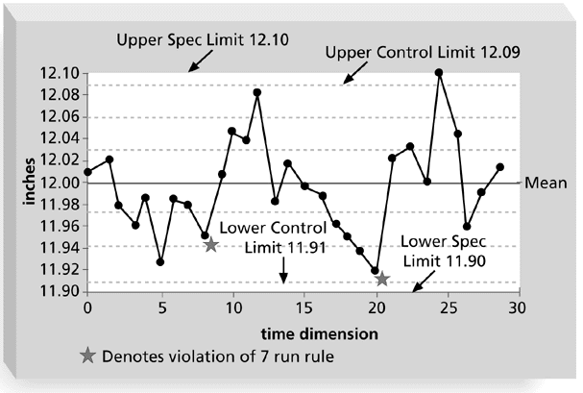
Contd.
Example: The following slide is a control chart for the manufacture of 12” rulers
Upper and lower specifications are 12.10” and 11.9” – this is the range specified as acceptable by the customer for purchase
The controls limits of 11.91” and 12.09” mean that the manufacturing process is designed to produce rulers within that range
The rule violations indicate that a calibration device may need adjustment

Slide 26
Data Collection Methods
To derive conclusions from data, we need to know how the data were collected; that is, we need to know the method(s) of data collection. There are two ways in which the required information may be obtained.
i) Complete enumeration survey or census method:
A census is a study that obtains data from every member of a population. In most studies, a census is not practical, because of the cost and/or time required.
Ii) Sampling method:
A sample survey is a study that obtains data from a subset of a population, in order to estimate population attributes.

Slide 27
Sampling
Sampling is concerned with the selection of a subset of individuals or within a statistical population to estimate characteristics of the whole population.
According to statistics regularity, moderately amount of data collected by selected items by the random number of group are almost similar to the average of data collected by items possess by the larger population. By random selection, we mean a selection where each and every item of the population has an equal chances of being selected in the sample. So sample selection should be in such a manner that represent the population.
Example: A survey without sampling(Population of New Guinea )
726,680 children less than 5 years of age
1,298,503 women 15-49 years of age
If one survey team could collect data on 13 women and 13 children per day, 6 teams would take 16,648 days or 45.6 years to complete data collection. (And that does not allow for any travel time or rest days for the survey workers.)
Notes:
Complete enumerated survey or Censes method
Sampling

Slide 28
Contd..
There are two methods for Statistical Sampling:
1: Random Sampling or Chance selection:
every item of the population has an equal chance of inclusion as the sample.
Simple Random Sampling
Stratified Sampling
Systematic Sampling
2: Non Random Sampling: Non-probability sampling is a sampling technique where the samples are gathered in a process that does not give all the individuals in the population equal chances of being selected. In this types of sampling items for the sampling are selected deliberately by the researcher.
Judgment Sampling
Quota Sampling
Convenience Sampling

Slide 29
Simple Random Sampling:
It refers to the sampling technique in which each and every item of the population
Lottery Method
Table of Random Numbers is given an equal chance of being included in the sample.

Slide 30
Stratified Random Sampling:
Useful when the population is heterogeneous and the population may be divided into homogeneous groups or classes called strata. Then a sample may be taken from each group by simple random sampling method and the resulting sampling is called a stratified sample.
A stratified random sample is obtained by separating the population into mutually exclusive sets, or strata, and then drawing simple random samples from each stratum.
Ex. All india survey of a market of a product “XYZ”
Strata 2 : Age
< 20
20-30
31-40
41-50
51-60
> 60
Strata 3 : Occupation
professional
clerical
blue collar
other
Strata 1 : Gender
Male
Female

Slide 31
Systematic Sampling
Popularly used in those cases where a complete list of the population from which sampling is to be drawn is available.
The method is to select every Kth item from the list where k refers to the sampling interval.
Ex. If a complete list of 1,000 students of a college is available and if we want to draw a sample of 200 students, this means we must take every fifth item(i.e k=5). The first item between one and five shall be selected at random.

Slide 32
Judgmental Sampling
Judgmental or Purposive sampling is a method of sampling where by the sampler picks the sample from the entire population solely based on the his/her judgment. The sampler controls to a very large extend which elements have a chance of being selected to be in the sample and which ones don't. judgment sampling is subject to the researcher's biases and is perhaps even more biased.

Slide 33
Convenience Sampling
It is a method of sampling where by the sampler picks the sample based on the fact or elements that he/she picks are conveniently close at the moment.
Ex. Let’s say that a researcher is interested in studying drinking behaviors among college students.
This would be an example of a convenience sample because the researcher is simply using subjects that are convenient and readily available. This sample would not be representative of all college students and therefore the researcher would not be able to generalize his or her findings to all college students.

Slide 34
Quota sampling
This is one of the most common forms of non-probability sampling. Sampling is done until a specific number of units (quotas) for various sub-populations have been selected. Since there are no rules as to how these quotas are to be filled, quota sampling is really a means for satisfying sample size objectives for certain sub-populations.
Ex. The quotas may be based on population proportions. Quota sampling is a type of judgmental sampling. Quotas are set up according to given criteria but within the quotas the selection of sample items depend on personal judgment. For example, if there are 100 men and 100 women in a population and a sample of 20 are to be drawn to participate in a cola taste challenge, you may want to divide the sample evenly between the sexes—10 men and 10 women. Quota sampling can be considered preferable to other forms of non-probability sampling (e.g., judgment sampling) because it forces the inclusion of members of different sub-populations.

Slide 35
The Cost of Quality
Perhaps the most obvious tangible benefit of quality improvement is the reduction of cost associated with quality and non quality. If we gone throw wrong way by made a mistake in manufacturing a product, it is clear that there is an immediate impact on the financials.
The cost of quality is the cost of conformance plus the cost of nonconformance
Conformance cost means delivering of the product that meets requirements and fit for use
Cost of nonconformance means taking responsibility for failures or not meeting quality expectations
Five Cost Categories Related to Quality:
Prevention cost: cost arise to keep away defects from occurring by planning and executing a plans(Quality control plan, Quality training and workforce development, project design verification, market research, etc) so it become error-free or within an acceptable error range
Appraisal cost: cost arise from detecting defects (evaluating processes and their outputs) via test, inspection, quality audit, testing.
Internal failure cost: cost arise from defects caught internally and to correct identified defect before the customer receives the product (rework, inventory costs due to defects, premature failure of products, rejection paper work)
External failure cost: cost arise from defect that actually reach the final customer (warranty costs, product liability suits, product recall)
Measurement and test equipment costs: capital cost of equipment used to perform prevention and appraisal activities

Slide 36
Testing
Testing is the process of evaluating a system or its component(s) with the intent to find whether it satisfies the specified requirements or not.
Testing is executing a system in order to identify any gaps, errors, or missing requirements. It includes activities that ensure the identification of bugs/error/defects .
It is product-oriented activities.
It is a preventive process.
Testing is the subset of Quality Control.
Note: Many IT professionals think of testing as a stage that comes near the end of IT product development.
Testing should be done during almost every phase of the IT product development life cycle

Slide 37
Types of Tests
Unit testing tests each individual component (often a module) to ensure it is as defect-free as possible.
Integration testing occurs between unit and system testing to test functionally grouped components.
System testing tests the entire system as one entity.
User acceptance testing is an independent test performed by end users prior to accepting the delivered system.

Slide 38
Total Quality Management (TQM)
Managers realized that “quality of management” is more important than “management of quality.” Birth of the term Total Quality Management (TQM).
TQM – Integration of quality principles into organization’s management systems.
The word "total" means the total of everything in an organization. That is, it covers every process, every job, every resource, every output, every person and every place.

Slide 39
TQM..
“Total Quality Management (TQM) is a comprehensive and structured approach to organizational management that seeks to improve the quality of products and services through ongoing refinements(Continuous Improvement) in response to continuous feedback. “
According to the American Society for Quality Control (ASQC), “total quality management (TQM) is a management approach to long-term success through customer satisfaction. TQM is based on the participation of all members of an organization to improving processes, products, services, and the culture they work in. TQM benefits all organization members and society.”
TQM requirements may be defined separately for a particular organization or may be in adherence to established standards, such as the International Organization for Standardization's ISO 9000 series. TQM can be applied to any type of organization; it originated in the manufacturing sector and has since been adapted for use in almost every type of organizations including schools, highway maintenance, hotel, etc.

Slide 40
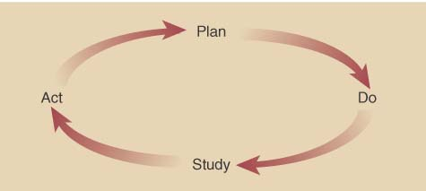
TQM..
Goal of the TQM is “Do the right things right at the first time, every time.”.
TQM processes are divided into four sequential categories:
Plan, Do, Check, and Act (the PDCA cycle).
In the planning phase, people define the problem to be addressed, collect relevant data, and ascertain the problem's root cause; in the doing phase, people develop and implement a solution, and decide upon a measurement to gauge its effectiveness; in the checking phase, people confirm the results through before-and-after data comparison; in the acting phase, people document their results, inform others about process changes, and make recommendations for the problem to be addressed in the next PDCA cycle.
The three aspects of TQM:
1: Tools, techniques, and training in their use for analyzing, understanding, and solving quality problems
2: Quality for the customer as a driving force and central concern.
3: Shared values and beliefs, expressed by leaders, that define and support quality.

Slide 41
The TQM System
Objective
Continuous
Improvement
Principles
Customer
Focus
Process
Improvement
Total
Involvement
Leadership Education and Training
Supportive structure Communications
Reward and recognition Measurement
Elements

Slide 42
Continuous Improvement versus Traditional Approach
Traditional Approach
Continuous improvement
Market-share focus
Individuals in team
Focus on ‘who” and “why”
Short-term focus
Status quo focus
Product focus
Innovation
Fire fighting
Customer focus
Cross-functional teams
Focus on “what” and “how”
Long-term focus
Continuous improvement
Process improvement focus
Incremental improvements
Problem solving

Slide 43
Elements of TQM
Be customer focused: It requires the company to check customers' attitudes regularly and includes the idea of internal customers as well as external ones.
Do it right the first time: This means avoiding rework, i.e., cutting the amount of defective work.
Constantly improve: Continuous improvement allows the company gradually to get better.
Quality is an attitude: Every one has to be committed to quality. That means changing the attitude of the entire workforce, and altering the way the company operates.
Telling staff what is going on: This involves improved communication. Typically, it includes team briefing.
Educate and train people: An unskilled workforce makes mistakes. Giving more skills to workers means they can do a wider range of jobs, and do them better. It also means educating staff in the principles of TQM, which is a whole new style of working.

Slide 44
Contd…
Measure the work: Measurement allows the company to make decisions based on facts, not opinion. It helps to maintain standards and keep processes within the agreed tolerances.
Top management must be involved: If senior management is not involved, the program will fail.
Make it a good place to work: Many companies are full of fear. Staffs are afraid of the sack, their boss and making mistakes. There is no point in running a TQM program unless the company drives out fear.
Introduce team work: Team work boosts employees' morale. It reduces conflict and solves problem by hitting them with a wider range of skills. It pushes authority and responsibility downwards and provides better, more balanced solutions.
Organize by process, not by function: This element of TQM seeks to reduce the barriers that exist between different departments, and concentrates on getting the product to the customer.

Slide 45
The Deming Management Method
The Deming Philosophy
Definition of quality, “A product or a service possesses quality if it helps somebody and enjoys a good and sustainable market.”
Improve quality
Decrease cost because of less rework, fewer mistakes.
Productivity improves
Long-term competitive strength
Stay in business
Capture the market with better quality and reduced cost.

Slide 46
The Deming Management Method
1) Create constancy of purpose for improvement of product and service.
2) Adopt the new philosophy of total quality.
3) Cease dependence on mass inspection to achieve quality.
4) End the practice of awarding business based on price tag alone.
5) Improve constantly and forever the system of production and service.
6) Institute training on the job.
7) Institute leadership.
8) Drive out fear of job insecurity.
9) Break down barriers between departments or staff areas.
10) Eliminate slogans, exhortations, and targets for the workforce.
11) Eliminate numerical quotas, goals, and work standards.
12) Remove barriers to pride of workmanship.
13) Institute a vigorous program of education and retraining for everyone.
14) Put everyone to work to accomplish the transformation.

